Slide 1
Realism

Slide 2
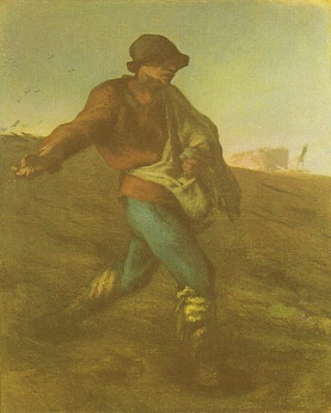
Jean-François Millet, The Sower, 1850

Slide 3
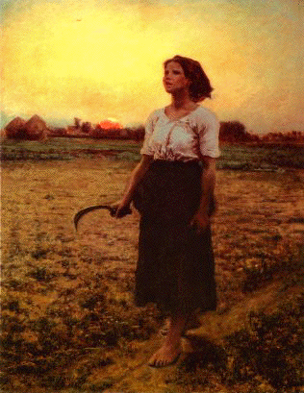
Jules Breton, The Song of the Lark, 1884

Slide 4
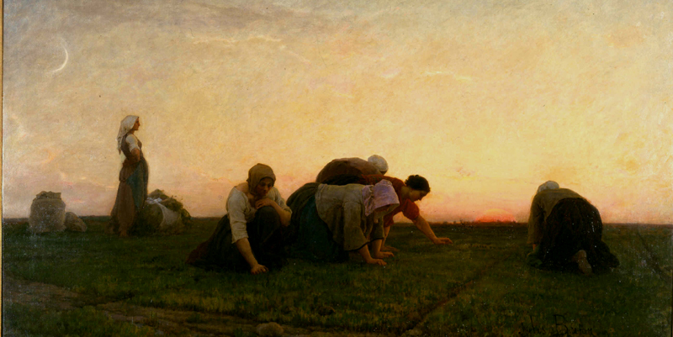
Jules Breton, The Weeders, 1868

Slide 5
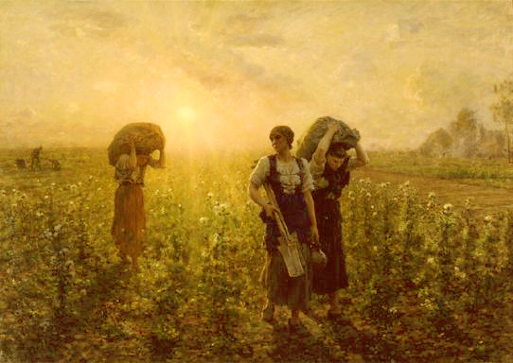
Jules Breton, Fin du Travail (End of the Working Day), 1886-1887

Slide 6
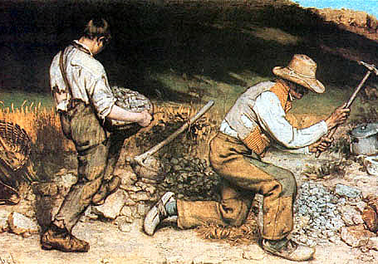
Gustave Courbet, The Stone Breakers, 1849

Slide 7
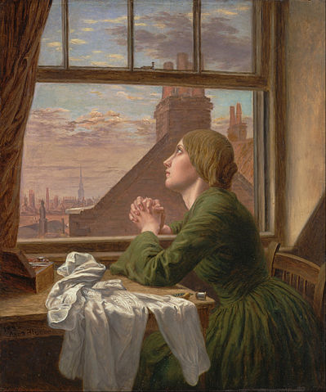
Anna Blunden, ‘For Only One Short Hour’ (1854)

Slide 8
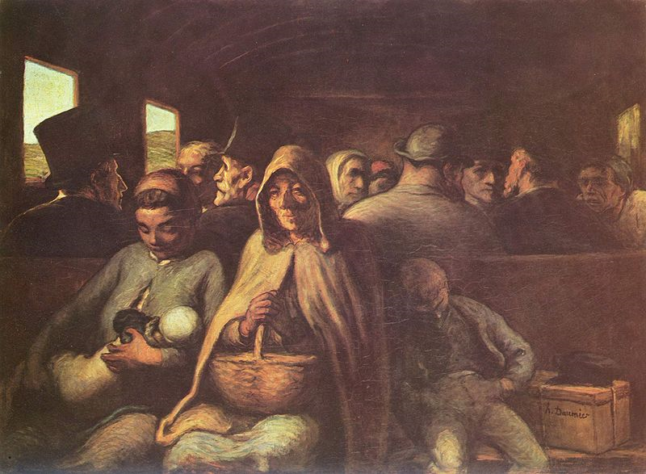
Honoré Daumier, The Third-Class Carriage, 1864

Slide 9
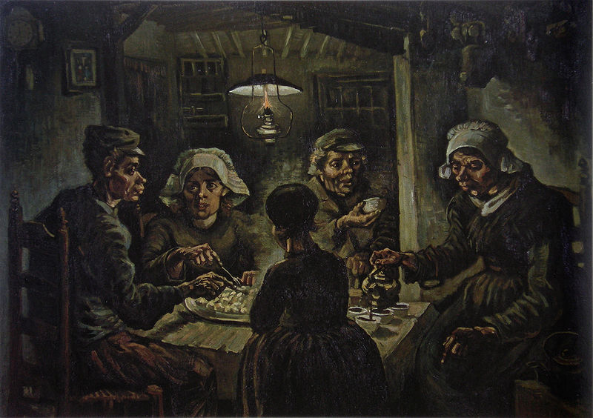
Vincent van Gogh, De Aardappeleters (The Potato Eaters), 1885

Slide 10
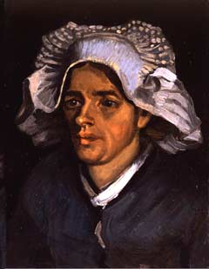

Slide 11
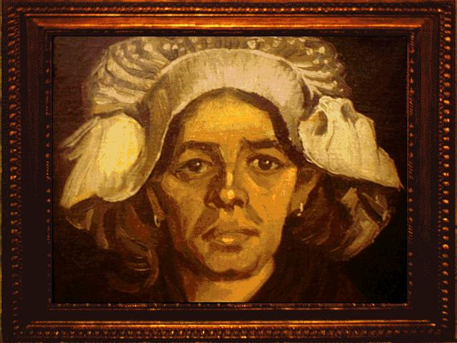

Slide 12
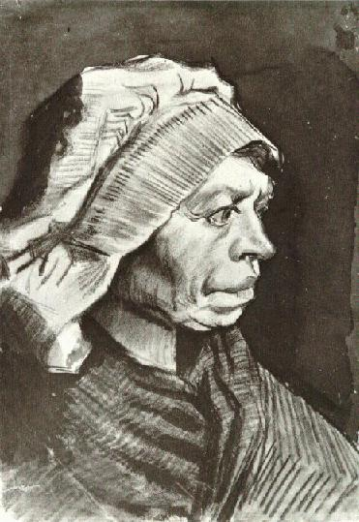

Slide 13
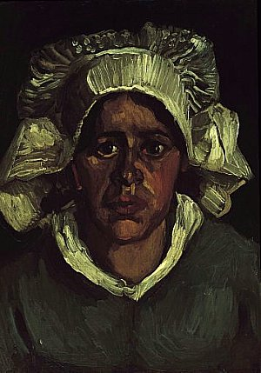

Slide 14
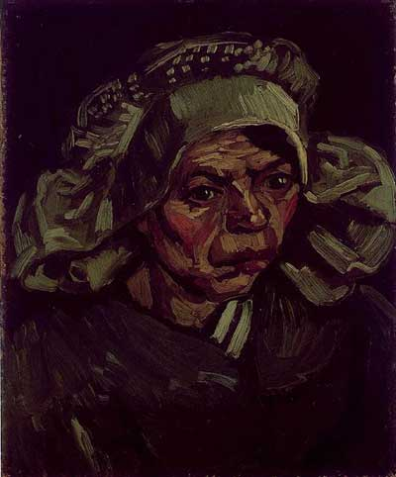

Slide 15
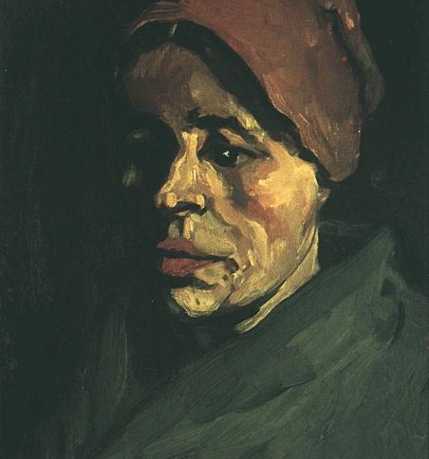
Vincent van Gogh, Head of a Peasant Woman with Brownish Cap, January 1885

Slide 16
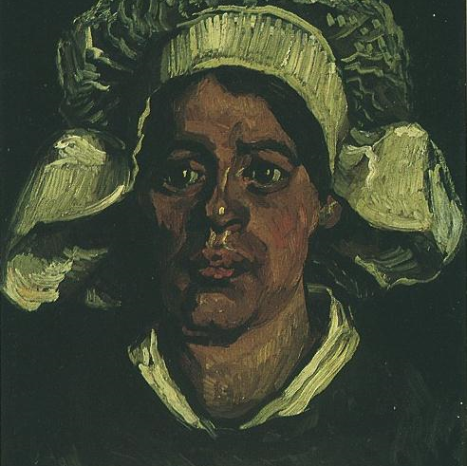
Vincent van Gogh, Head of a Peasant Woman with White Cap, March-April 1885

Slide 17
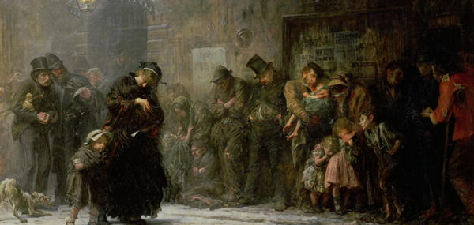
Luke Fildes, Applicants for Admission to a Casual Ward (1874)

Slide 18
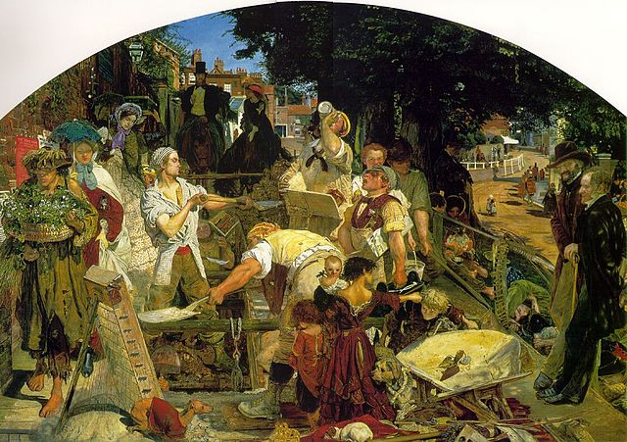
Ford Madox Brown, Work (1862-1863)

Slide 19
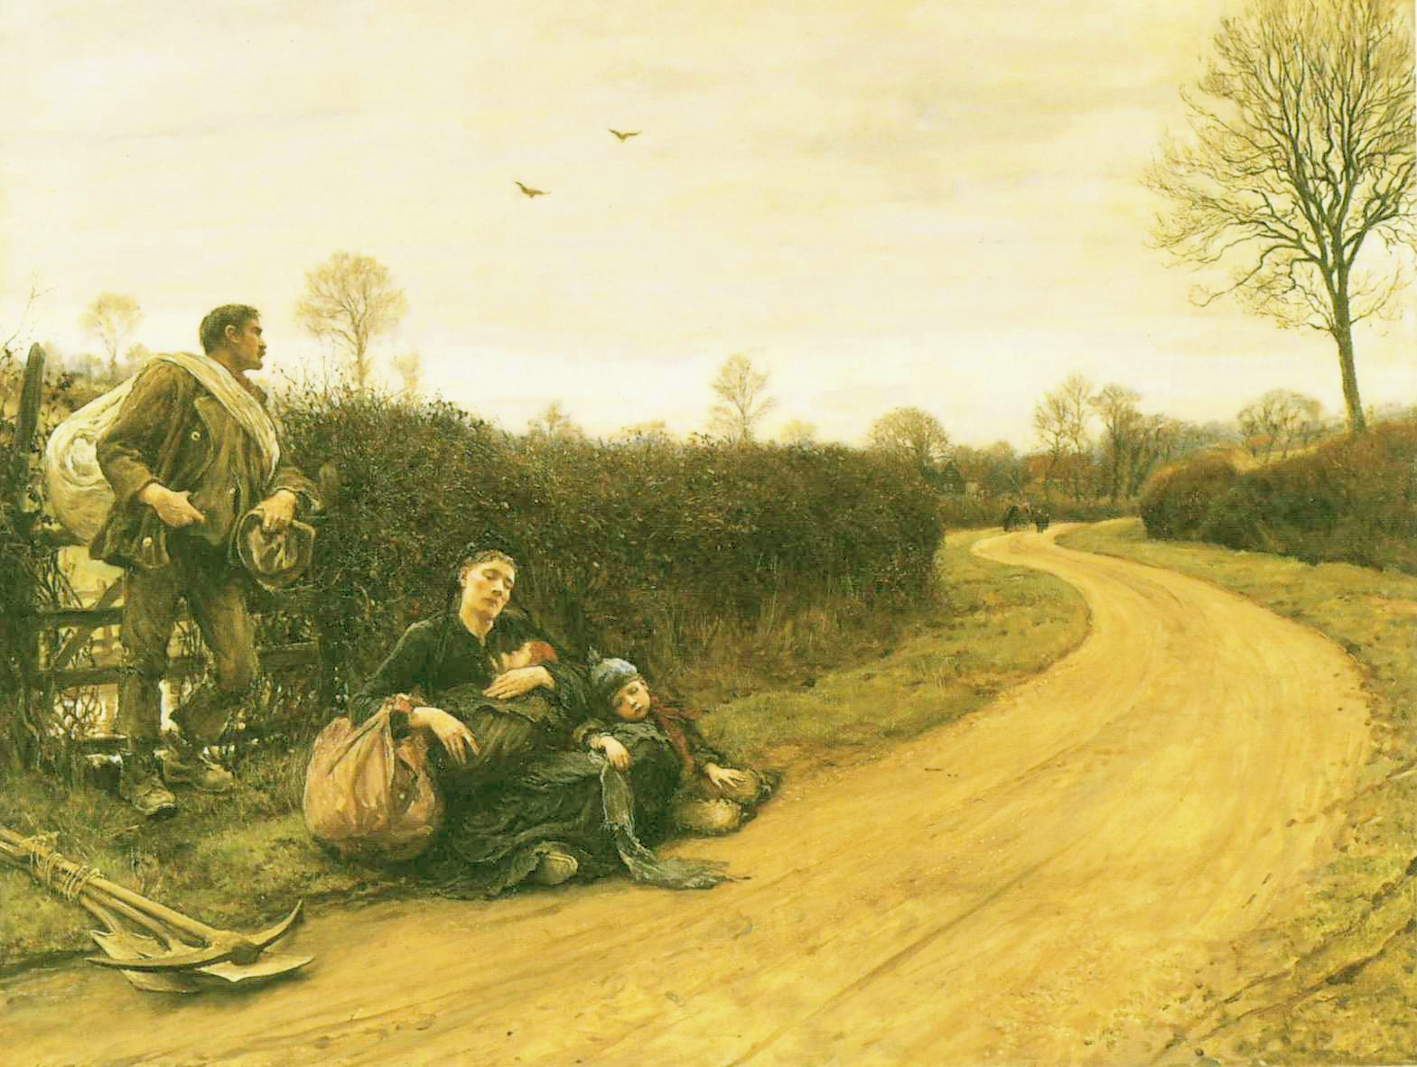
Hubert von Herkomer, Hard Times (1885)

Slide 20
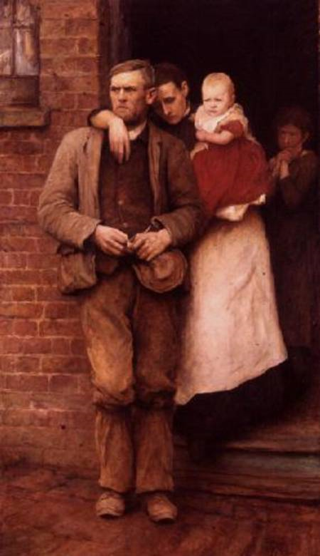
Hubert von Herkomer, On Strike, 1891

